Slide 1
Shared Robo-Vision
Alberto Vaccari | Yu Liu | Dapeng Lan

Slide 2
Introduction
Notes:
<number>

Slide 3
Introduction
Notes:
<number>

Slide 4
Introduction
<TO DO>
Notes:
<number>

Slide 5
System Diagram
Notes:
<number>

Slide 6
System Diagram
Notes:
<number>

Slide 7
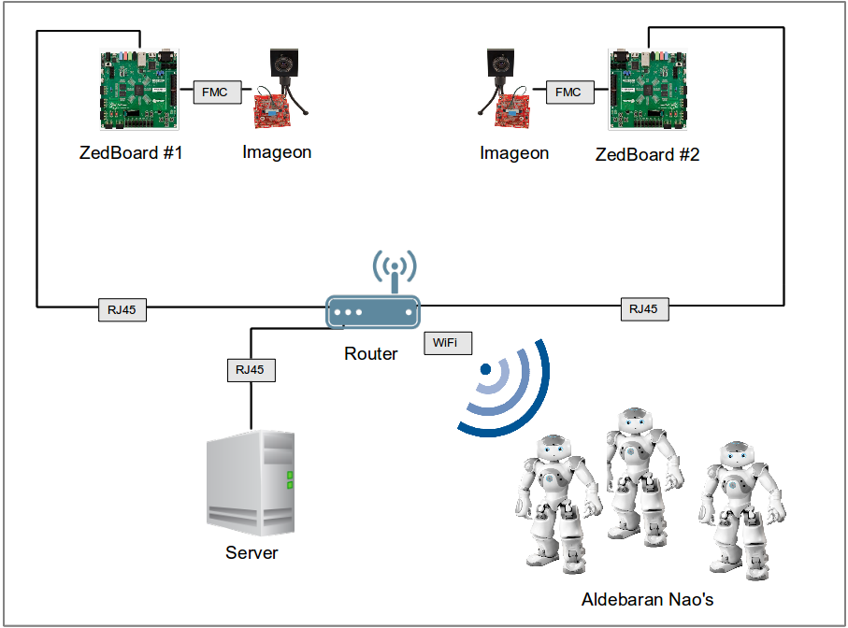
System Diagram
Notes:
<number>

Slide 8
Objectives
Notes:
<number>

Slide 9
Objectives
Notes:
<number>

Slide 10
Objectives
Transmit HD images (1920*1080) from 2 ZedBoards to a computer
Perform some degree of image processing directly on the ZedBoards
Track the position of the robots on the field
Track the position of the ball on the field
Record a match
Replay a recorded match
Control the movements of the robots from the server application
Notes:
<number>

Slide 11
Roles
Notes:
<number>

Slide 12
Roles
Notes:
<number>

Slide 13
Roles
Alberto:
☐ Tracking of the robots
☐ Tracking of the ball
☐ Recording a match
☐ Replaying a saved match
☐ Communication and control of the robots
Yu:
☐ Receiving images from the ZedBoard
☐ Image pre-processing on the ZedBoards
Dapeng:
☐ Fetching HD images from FMC-Imageon V2000C camera
☐ Transmission of HD images from 2 ZedBoards to the server
☐ Image pre-processing on the ZedBoards
Notes:
<number>

Slide 14
Roles
Alberto:
☑ Tracking of the robots
☑ Tracking of the ball
☑ Recording a match
☑ Replaying a saved match
☑ Communication and control of the robots
Yu:
☑ Receiving images from the ZedBoard
☐ Image pre-processing on the ZedBoards
Dapeng:
☑ Fetching HD images from FMC-Imageon V2000C camera
☒ Transmission of HD images from 2 ZedBoards to the server
☐ Image pre-processing on the ZedBoards
Notes:
<number>

Slide 15
Hardware
Notes:
<number>

Slide 16
Hardware
Notes:
<number>

Slide 17
Hardware - Introduction
Notes:
<number>

Slide 18
Hardware - Results
Notes:
<number>

Slide 19
Hardware – Problems
Notes:
<number>

Slide 20
Software
Notes:
<number>

Slide 21
Software – Robot Tracking
Notes:
<number>

Slide 22
Software – Robot Tracking
Initial intuition:
Use already existing patterns on Nao
Notes:
<number>

Slide 23
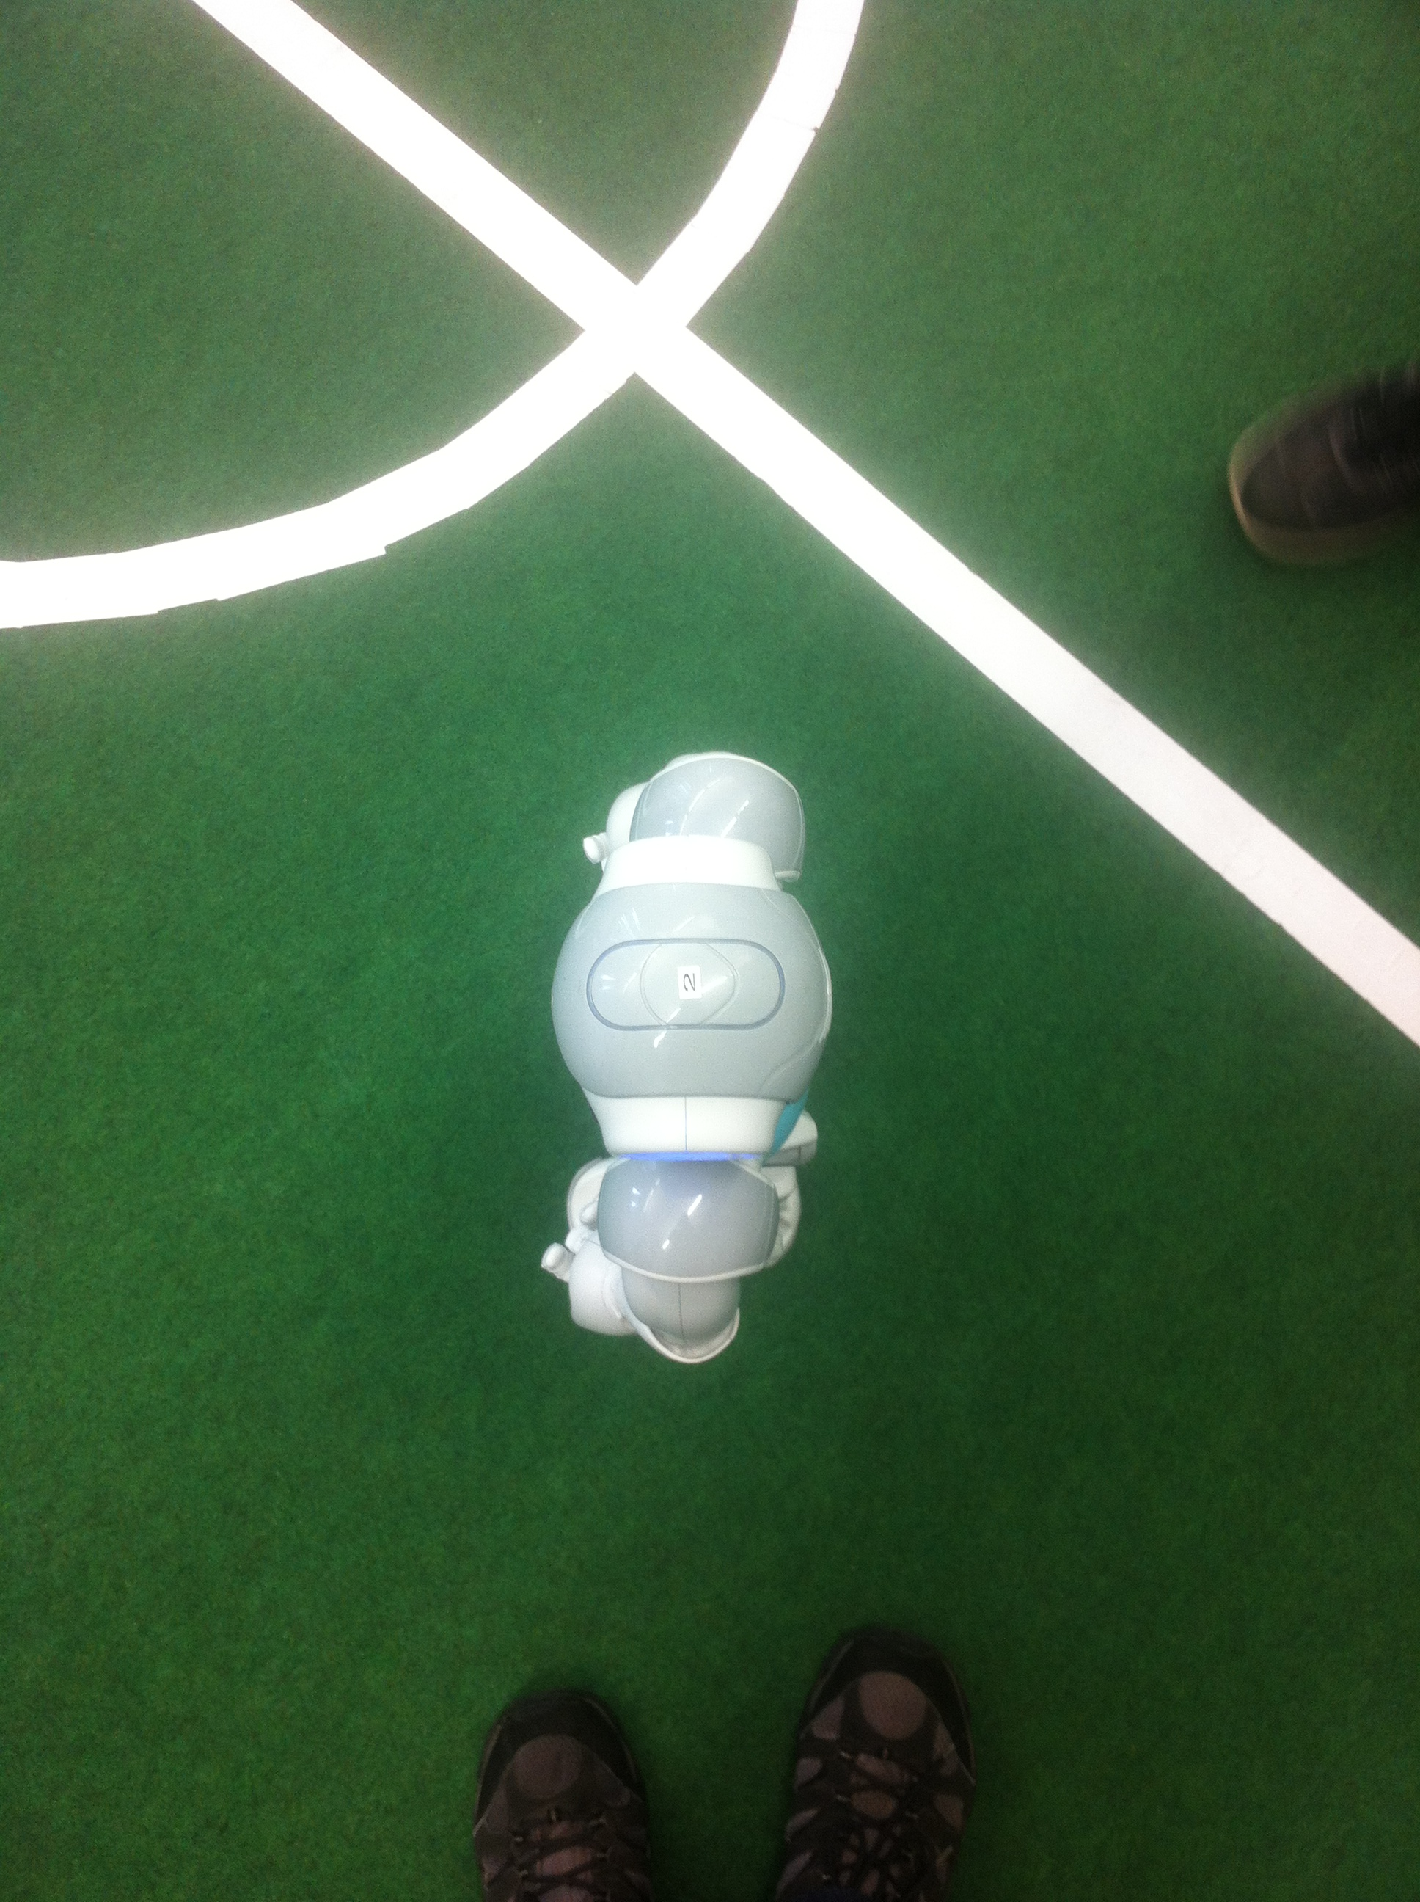
Software – Robot Tracking
Initial intuition:
Use already existing patterns on Nao
Notes:
<number>

Slide 24

Software – Robot Tracking
Initial intuition:
Use already existing patterns on Nao
Notes:
<number>

Slide 25
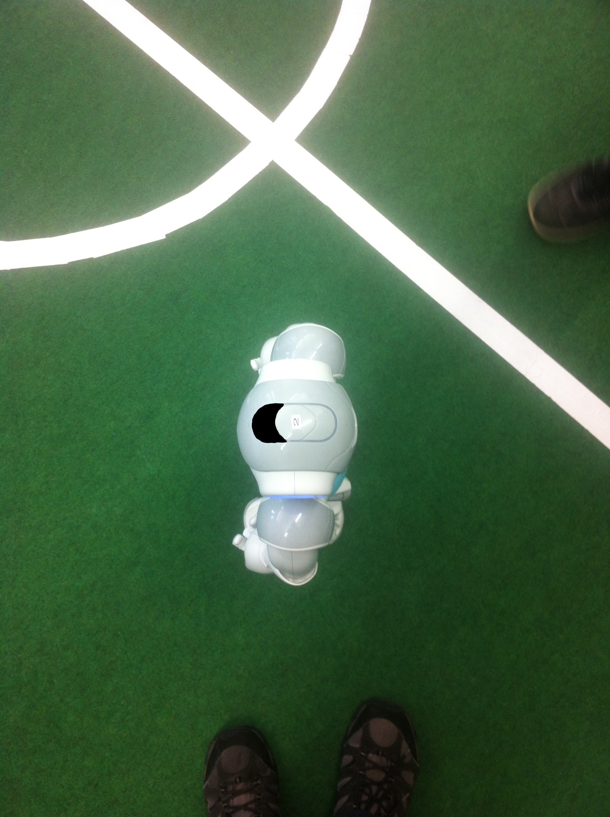
Software – Robot Tracking
Initial intuition:
Use already existing patterns on Nao
Notes:
<number>

Slide 26
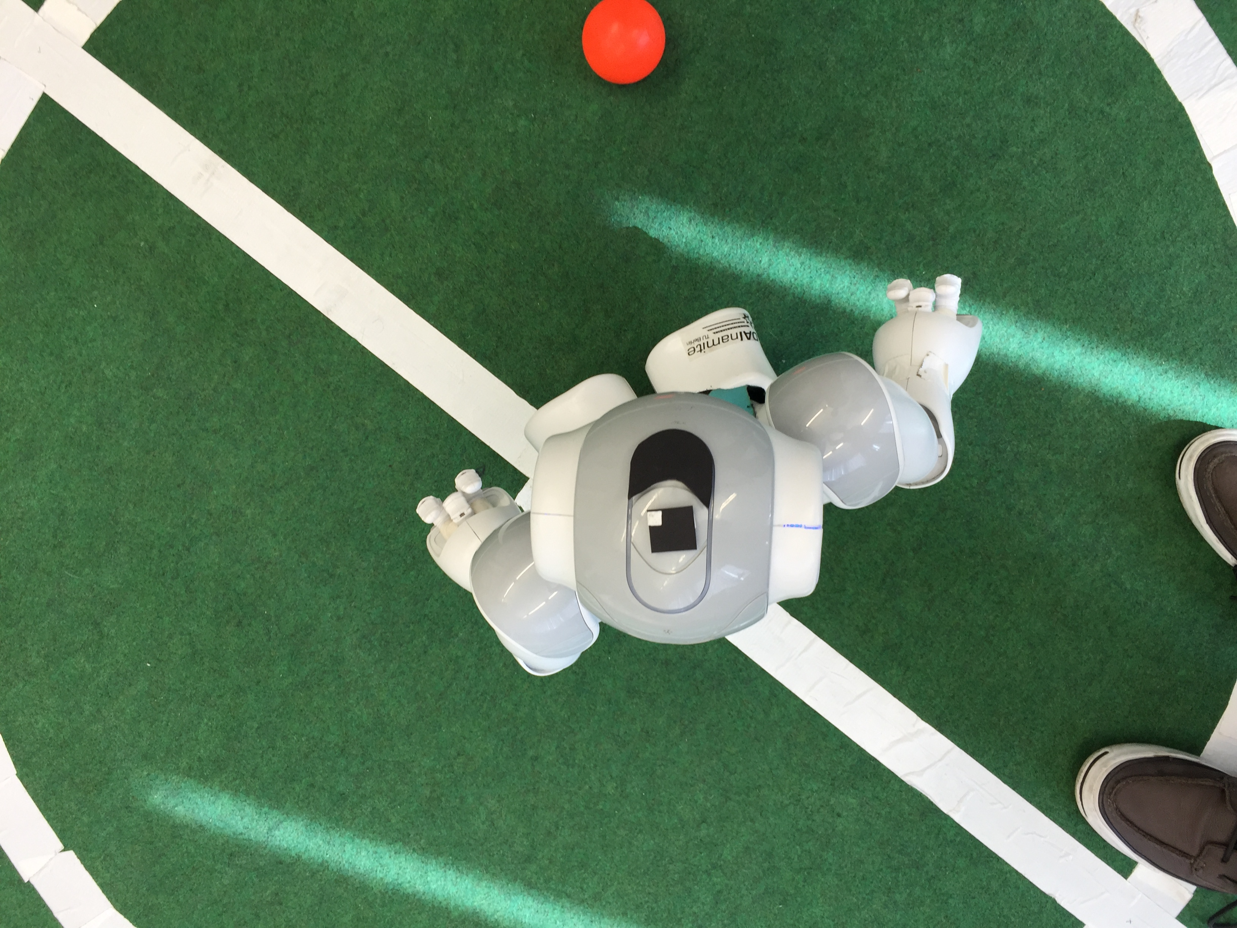
Software – Robot Tracking
Initial intuition:
Use already existing patterns on Nao
Add marker to uniquely identify each robot
Notes:
<number>

Slide 27
Software – Robot Tracking
Problems with initial intuition:
Custom shape matching not directly providing angles
Additional processing for the custom ID marker
Notes:
<number>

Slide 28
Software – Robot Tracking
Problems with initial intuition:
Custom shape matching not directly providing angles
Additional processing for the custom ID marker
Solution:
Notes:
<number>

Slide 29

Software – Robot Tracking
Problems with initial intuition:
Custom shape matching not directly providing angles
Additional processing for the custom ID marker
Solution: ArUco markers
Notes:
<number>

Slide 30
Software – Robot Tracking
Problems with initial intuition:
Custom shape matching not directly providing angles
Additional processing for the custom ID marker
Solution: ArUco markers
Provide 3D coordinates and marker rotation
Provide up to 1023 unique ID's
Easy implementation
Rapid markers detection
Notes:
<number>

Slide 31
Software – Ball Tracking
Notes:
<number>

Slide 32
Software – Ball Tracking
Initial intuition:
Filter non-red elements from the frame
Use HoughCircles to find circular objects with specific size
Notes:
<number>

Slide 33
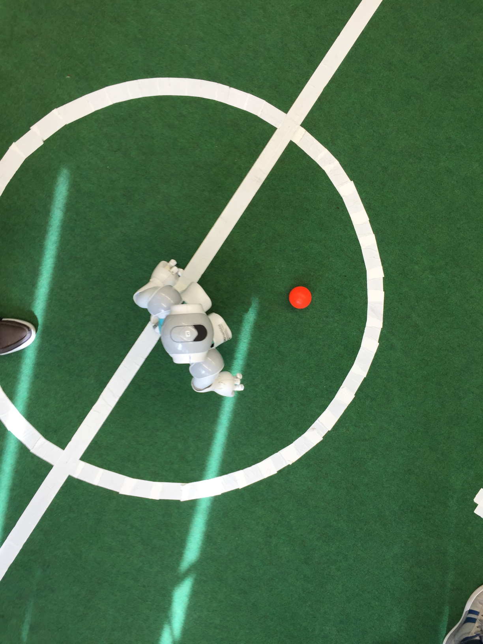
Software – Ball Tracking
Initial intuition:
Filter non-red elements from the frame
Use HoughCircles to find circular objects with specific size
Notes:
<number>

Slide 34

Software – Ball Tracking
Initial intuition:
Filter non-red elements from the frame
Use HoughCircles to find circular objects with specific size
Notes:
<number>

Slide 35
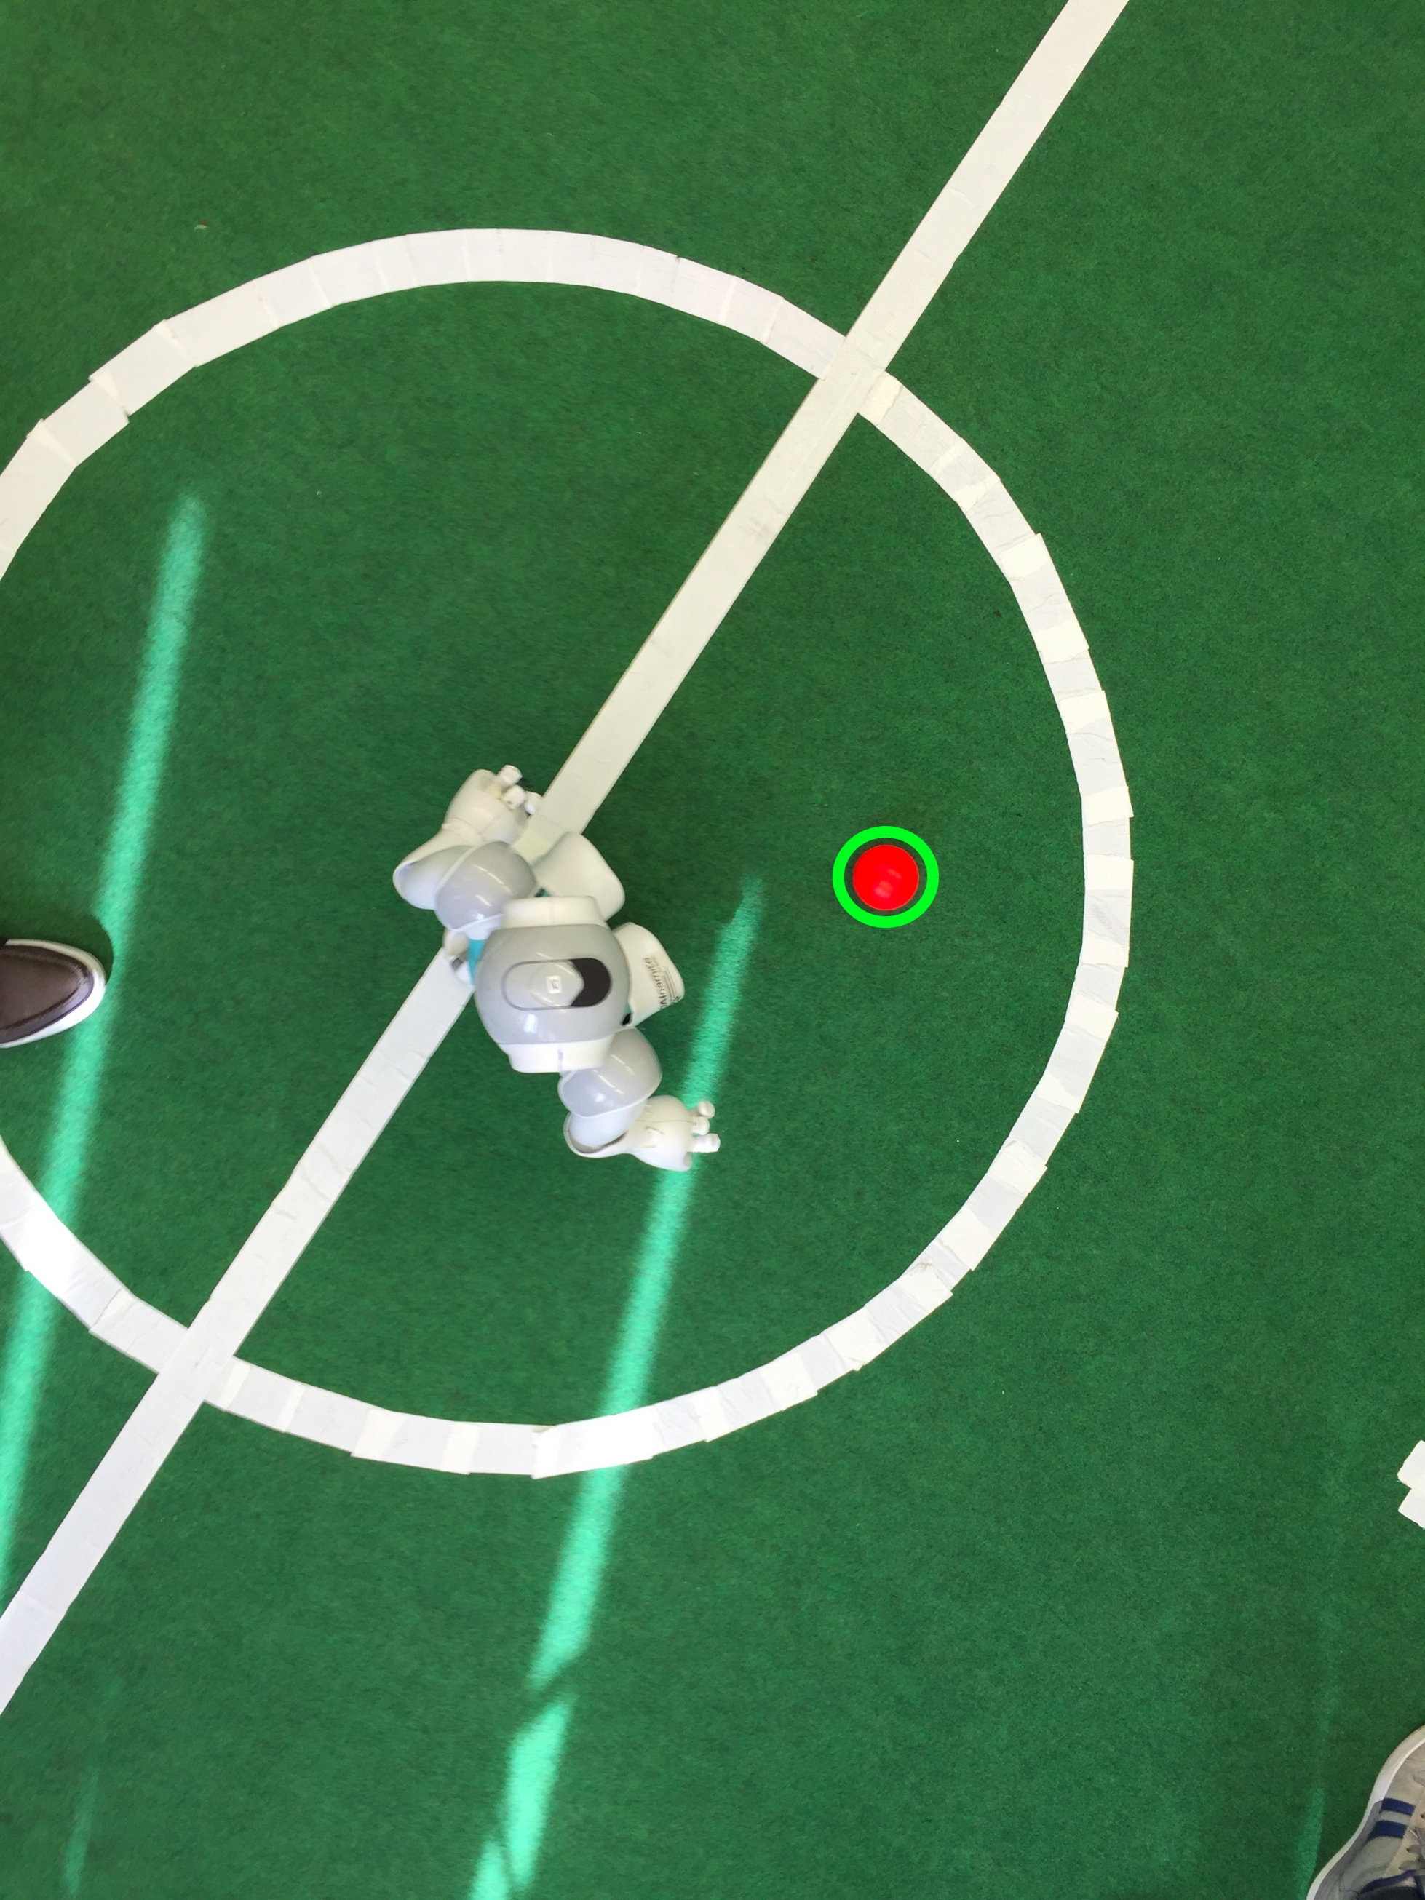
Software – Ball Tracking
Initial intuition:
Filter non-red elements from the frame
Use HoughCircles to find circular objects with specific size
Notes:
<number>

Slide 36
Software – Robot Control
Notes:
<number>

Slide 37
Software – Robot Control
Control robots from the application through the network (WiFi, using UDP):
Notes:
<number>

Slide 38
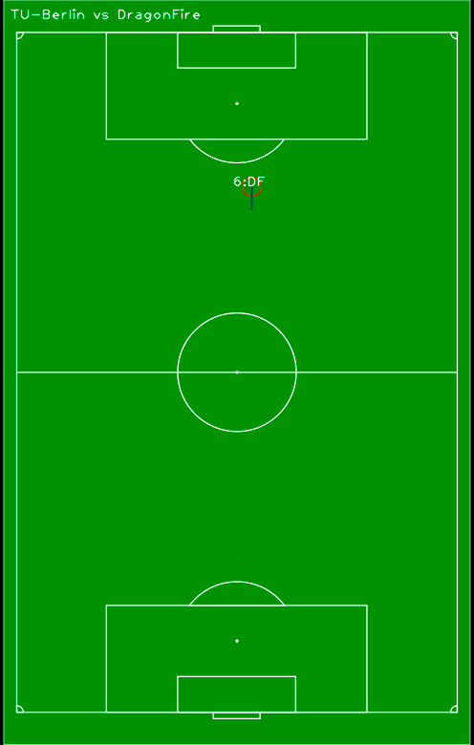
Software – Robot Control
Control robots from the application through the network (WiFi, using UDP):
Notes:
<number>

Slide 39
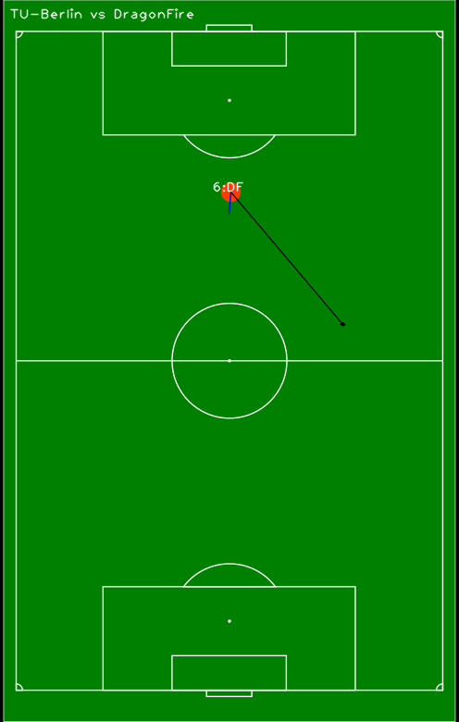
Software – Robot Control
Control robots from the application through the network (WiFi, using UDP):
Notes:
<number>

Slide 40
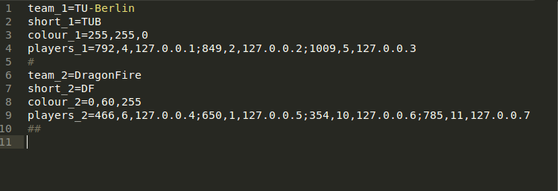
Software – Robot Control
Robot information (Team Name, Team Colour, Players and IPs) stored in configuration file:
Notes:
<number>

Slide 41
DEMO
Notes:
<number>

Slide 42
The End
Alberto Vaccari | Yu Liu | Dapeng Lan

